Slide 1

MINI PROJECT
EMPLOYEE APPRECIATION BASED ON CUSTOMER SATISFACTION USING IBM COGNITIVE SERVICES
PRESENTED BY:
Chilupuri Shalini (18UK1A05M3)
Satla Ramakrishna (18UK1A05M2)
Pulicherla Pranavi (18UK1A05G8)
Zubair Ur Rahman (18UK1A05F8)
PRESENTED TO:
Prashanth(Mentor).

Slide 2
Table of Contents
Introduction
Block diagram
Hardware and software requirements
Experimental investigation

Slide 3
INTRODUCTION
Employee satisfaction is a measure of how happy workers are with their job and working environment. Keeping morale high among workers can be tremendous benefit to any company because happy workers are more likely to produce more, take fewer days off and stay loyal to the company. There are many factors in improving or maintaining high employee satisfaction. The way they treat your customers According to a recent article, creating an employee recognition culture can increase employee retention by up to 31%. Employee recognition is the process of showing appreciation for an employee’s achievements, actions, and contributions. In big companies (Amazon/Swiggy/Uber) appreciation is given to the employees based on the customer feedback or satisfaction (chat process/ voice process). Analyzing all the feedback of each customer towards an employee work manually is a tedious job. The main objective of this guided project is to appreciate the employee work based on analysis of customer feedback. We are designing an application where the HR/ user can upload the feedback report of all the employees. The analysis of each employee report is displayed on the Web application in the form of Bar charts.

Slide 4
HARDWARE AND SOFTWARE REQUIREMENTS
Create IBM Services.
Cloudant DB
Tone Analyzer
Upload Feedback data to Cloudant DB
Create a Cloudant database
Create Sentiment Analysis using NODE-RED
Build Web Applications

Slide 5
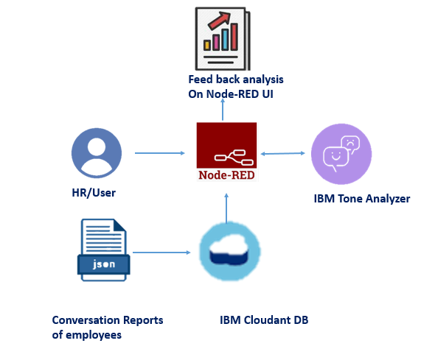
Theoretical Analysis

Slide 6
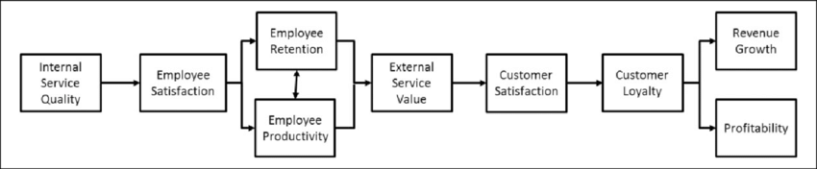
BLOCK DIAGRAM

Slide 7
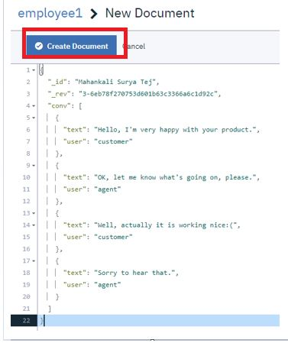
CREATION OF DATABASE

Slide 8
EXPERIMENTAL INVESTIGATION
Now it's time to analyze the feedback documents uploaded to the database. To accomplish that we create a node-red UI. User can select the name of the employee and the analysis of the feedbacks of a particular employee is showcased on UI.
Let us create a back-end Flow for this your node-RED flow contains the following Nodes
Dropdown node - to select the employee.
Cloudant DB node - to fetch the created Documents and store the analyzed sentiments.
Tone Analyzer - For emotion analysis.
line-chart- displays the graphs.
Function Nodes: to Parse the incoming messages. Now that you have created all the services, it's time to create the document (contains feedbacks of the customer for each employee ) to the Cloudant DB.

Slide 9
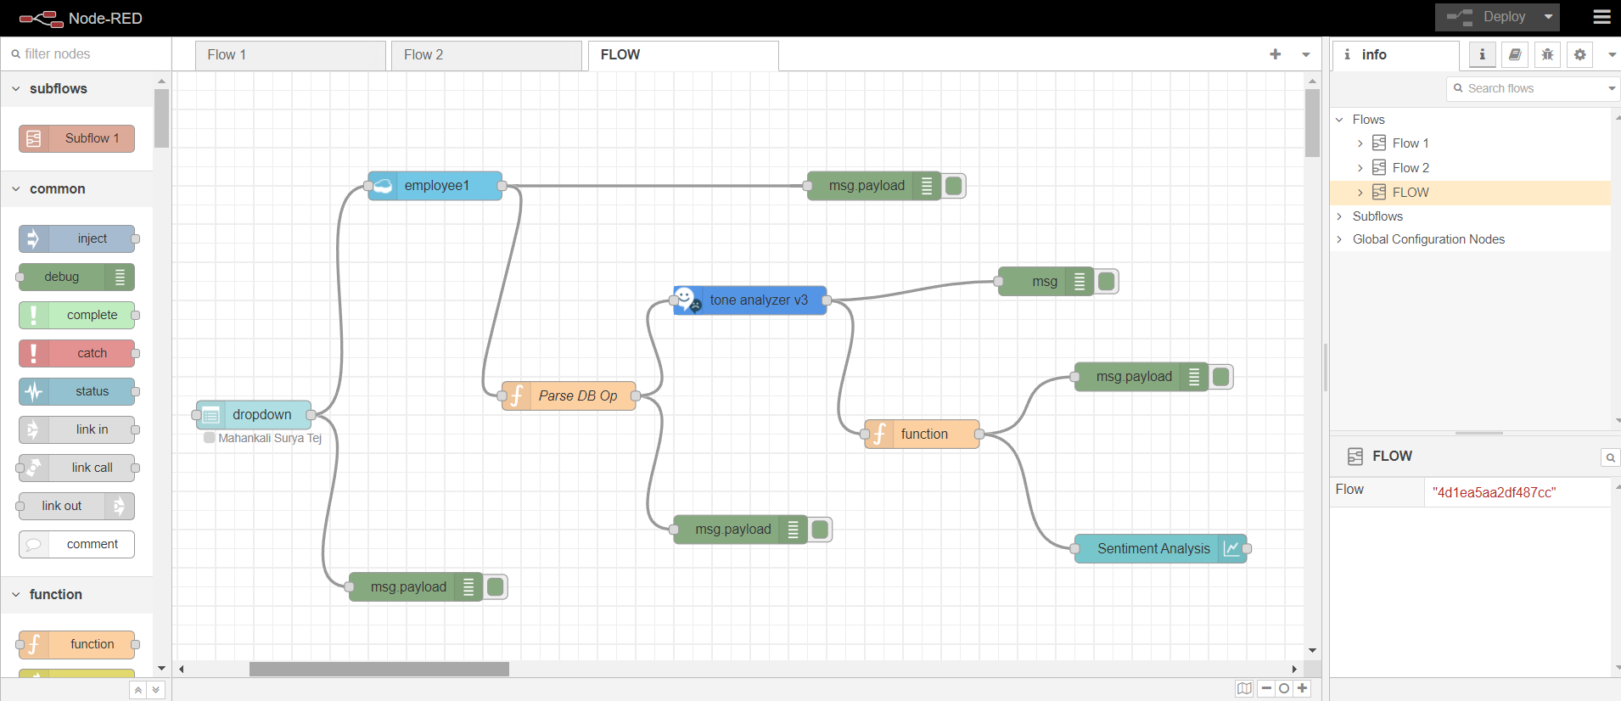
SENTIMENT ANALYSIS IN NODE-RED

Slide 10
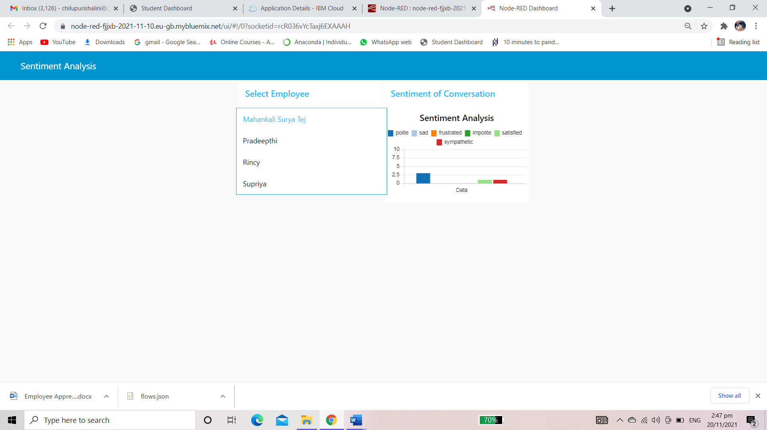

Slide 11
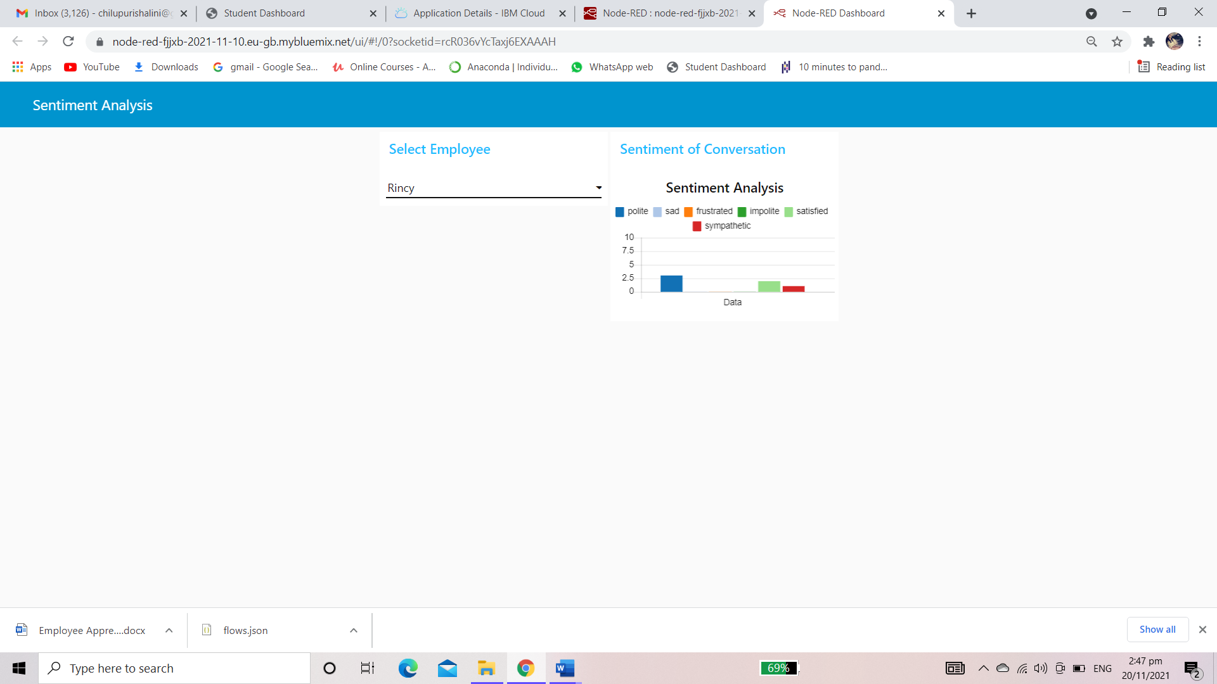

Slide 12
result
Employee appreciation is paramount for creating a positive work culture and positive customer experiences. The desire to be appreciated is at the core of human nature and according to psychologists, sincere appreciation is one of the best strategies for employee retention and happiness. Employee engagement activities are expensive and require weeks or months of planning. However, employee appreciation and recognition, which pretty much have the same effect on the business, can be started without spending much time, resources, or money.

Slide 13
THANK YOU…!

